Slide 1
CSE 219
Computer Science III
Software Development
Lifecycle

Slide 2
Who am I?
Richard McKenna
E-mail: richard@cs.stonybrook.edu
Phone: 631-632-9564
Office: CS Room 1436
Office hours:
  M 12pm – 1pm
  Tu 1pm – 2pm
  Th 1pm – 2pm
  F 12pm – 1pm
and by appointment
Personal Link:
http://www.cs.stonybrook.edu/~richard

Slide 3
Course Homepages
http://www.cs.stonybrook.edu/~cse219
  Syllabus
  schedule (lecture slides, hw, etc …)
  etc.
http://blackboard.stonybrook.edu
  grades

Slide 4
Course Description
Development of the basic concepts and techniques from Computer Science I and II into practical programming skills that include a systematic approach to program design, coding, testing, and debugging. Application of these skills to the construction of robust programs of 1000-2000 lines of source code. Use of programming environments and tools to aid in the software development process.
NOTE: You must have taken CSE 214 and received a grade of "C" or better in order to take this course

Slide 5
Course Topics
Project Technologies Basics
  GUIs & Event Programming
  2D Graphics
Software Design (UML)
Design Patterns
Programming style
Algorithms and data structure selection
Code maintenance & documentation

Slide 6
Course Topics (continued)
Effectively using an IDE & associated tools for:
  Designing
  Code editing
  Testing
  Debugging
  Revision control
  Profiling
  Documentation
  Deployment

Slide 7

Textbook #1
Head First Object Oriented Design and Analysis (on-line version)
by Brett McLaughlin, Gary Pollice, David West
Published by O'Reilly Media, Inc. 2006
Print ISBN-10: 0-596-00867-8
Print ISBN-13: 978-0-596-00867-3

Slide 8
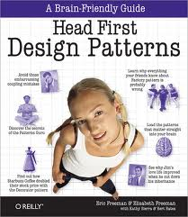
Textbook #2
Head First Design Patterns (on-line version)
by Eric T Freeman, Elisabeth Robson, Bert Bates, Kathy Sierra
Published by O'Reilly Media, Inc. 2004
Print ISBN-10: 0-596-00712-4
Print ISBN-13: 978-0-596-00712-6

Slide 9

Textbook #3
Core Java Volume 1 - Fundamentals (on-line version)
by Cay Horstmann
Prentice Hall, 2007.
ISBN 978-0132354769

Slide 10
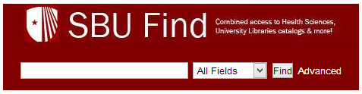
On-Line Textbooks
Via our Library
http://sbufind.library.stonybrook.edu/vufind/

Slide 11

Course IDE
NetBeans
Download
  http://netbeans.org/downloads/index.html
HW 1:
  NetBeans Tutorials
  Contract

Slide 12
Lab Facilities
CS Windows Lab
  http://www.cs.stonybrook.edu/facilities/windowslab
  CS 2114, CS 2120, CS 2126, & CS 2129
  all registered students have accounts
Room combo
  soon to follow

Slide 13
How are grades computed?
Final Exam 25 %
Midterm Exam 25%
6 Homework Assignments 30 % (5 % each)
Final Project 20 %
100 %
Note CEAS Policy:
  The Pass/No Credit (P/NC) option is not available for this course.

Slide 14
ACADEMIC DISHONESTY
All work you submit for homework, projects, or exams MUST be your own work.
If you cheat or aid someone in cheating, you will automatically fail this course and be brought up on charges of academic dishonesty without warning.
NO EXCEPTIONS WILL BE MADE!

Slide 15
The mystery of the disappearing student
Why would a student not take an exam, but remain registered for a course?
Why would a student not do any programming assignments, but remain registered for a course?

Slide 16
Rules of thumb to remember
3 ½ months is not a long time
Points are more difficult to makeup later in the semester
Have the same sense of urgency for the 1st assignment as you would for the last

Slide 17
So what is this course really about?
Short Answer:
  OOP mastery
  No more toys
  Plan, then do (design, then code)

Slide 18
The Long Answer
To learn a methodology for constructing software systems of high quality
What properties make a software system high quality?
  correctness
  efficiency
  ease of use (by other programmers in the case of frameworks)
  reliability/robustness
  maintainability
  modifiability
  extensibility
  scalability

Slide 19
KLOCs
As programs get larger, these become much more difficult to achieve. Why?
  program complexity
  team complexity (more people are involved)

Slide 20
How can these properties be achieved?
By using well proven, established processes
  preferably while taking advantage of good tools
Bottom Line:
  don’t be a flying by the seat of your pants software engineer
Requirements Analysis
Design & Document
Evaluate Design
Code
Test
Deploy
Profile
Debug

Slide 21
Other Steps to Consider
Integration
Maintenance

Slide 22
Integration
Done in large projects
Combine developed software into a cohesive unit
A
B
C
D
E
ABCDE

Slide 23
Software Maintenance
Follows Deployment
Monitoring and Updating deployed software

Slide 24
Updated Software Development Life Cycle
Waterfall Model
  Note there are many variations
Requirements Analysis
Design
Evaluate Design
Code
Test, Debug, & Profile Components
Integrate
Test, Debug, & Profile Whole
Deploy
Maintain

Slide 25
Note: there are other models
Agile Programming
Extreme Programming
Etc.
We’ll talk more about these at the end of the semester

Slide 26
Software Jobs
Not all of you are going to be programmers
  but you should know how to design, program, test, debug software
Other types of jobs:
  Designer
  Tester
  Database, Network, Security Administrator
  Project Leader
  Manager
  Professor
  etc …
NOTE: designers & programmers on a project may not be the same people

Slide 27
Design, then develop
We will design all classes before coding
  not easy to do
  UML is used for software design
You cannot design a system unless you really understand the necessary technology
  designs cannot be created without a little testing
    trying out different small-scale examples (HWs 2 & 3)

Slide 28
The HW Plan
HW 1 – Build Process
HW 2 – Technology Ramp-Up – GUIs, Events & XML
HW 3 – Technology Ramp-Up – 2D Graphics & Threads
HW 4 - UML Design
HW 5 – Implementation Stage #1
HW 6 – Implementation Stage #2
Final Project – Completed Work

Slide 29
What is a framework?
Groups of classes that form the basis for customization
  cooperating classes for a particular technology
    ex: multimedia, the Web, databases, etc.
  used to build new applications & other frameworks
  what’s Java’s application framework for the domain of GUI development?
    Swing (a framework built on the AWT framework)

Slide 30
Applications Using Frameworks
Framework
App1 calls methods of Framework objects
App2 calls methods of Framework objects
Framework calls methods of App1 & App2 objects
Application #1
Application #2
How can this happen?

Slide 31
Common Java Frameworks
1. Spring MVC (23%)
2. Struts 1.x (15%)
3. Apache Axis (15%)
4. Apache Xerces (14%)
5. Hibernate (12%)
6. JDOM (12%)
7. Java Applet (8.1%)
8. Apache Velocity (7.9%)
9. Apache ORO (7.0%)
10. JAX-WS (6.5%)
Source: VeraCode Blog
http://www.veracode.com/blog/2012/01/top-ten-java-frameworks-observed-in-customer-applications/

Slide 32
Framework Documentation
Frameworks are more than just one class, but many classes working together
Framework developers must explain how to use them all together properly
  API
  Tutorials
Frameworks are open source as well as for purchase

Slide 33
Who cares?
We are constantly using Java frameworks
Think about how you might create a framework
Gaining the ability to make frameworks will make you a powerful developer

Slide 34
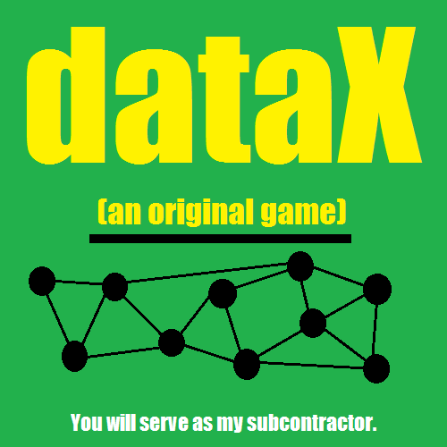
Your Project?

